Slide 1





MAMC01901 Business Analysis
Week 1 (Session 2): Introduction to Business Analysts

Slide 2



Agenda
Who is a business analyst?
What are the different types of business analysts?
Role of a business analyst in relation to the business analysis life cycle
Assessment 1 requirements

Slide 3
Who is a business analyst?
Who according to you is a business analyst?
https://www.youtube.com/watch?v=-psusaPKLg0

Slide 4
Who is a business analyst?
A business analyst (BA) is someone who helps organisations understand their problems or opportunities and find better ways to work.
They talk to people inside the organisation (like managers, staff, customers) to find out what’s working and what’s not.
They analyse information and spot patterns to figure out why problems are happening.
They recommend solutions — like changing a process, introducing new technology, or improving communication.
Business analysts connect the business side and the technical side (for example, helping the IT team understand what the business actually needs).
Their goal is to make the organisation perform better — saving money, making customers happier, or helping teams work more efficiently.

Slide 5
Evolution of the role
Started as problem-finders: Early on, business analysts mostly helped identify problems in systems or processes.
Moved to solution designers: Over time, they began helping design and suggest solutions, often working closely with IT teams.
Became strategic advisors: Now, they also help organisations make decisions by analysing data and understanding business needs.
Focus more on people and change: Today’s analysts often work with many teams and help manage change, not just systems.
Use digital tools and data: They now rely heavily on tools like Power BI, AI, and big data to give insights and support innovation.
From waterfall to agile!

Slide 6
Types of Business Analysts
According to the BABOK guide (Business Analysis Body of Knowledge), there are different types of analyst roles, depending on the area that the analyst focuses on.
Business Systems Analyst
Focuses more on technical systems and IT solutions.
Translates business needs into software/system requirements.
Process Analyst
Specialises in business processes (how work flows inside the organisation).
Works on improving processes to make them faster, cheaper, or better.
Data Analyst
Works mainly with data and information management.
Analyses data to help businesses make better decisions.

Slide 7
Types of Business Analysts
According to the BABOK guide (Business Analysis Body of Knowledge), there are different types of analyst roles, depending on the area that the analyst focuses on.
Enterprise Business Analyst
Works at a high, strategic level.
Focuses on business strategy, change initiatives, and big-picture improvements across the whole organisation.
Functional Business Analyst
Focuses on one department or function (like HR, Finance, or Marketing).
Understands both the business needs and the technical solutions for that area.
Agile Business Analyst
Works within Agile project teams.
Helps create and refine requirements quickly as the project moves along (especially using user stories, product backlogs, etc.).

Slide 8
Class activity
Explore job ads on seek/linkedIn related to business analysis
Note down the type of analyst and the area that the analyst needs to focus on
Compare different business analyst roles across different industries (identify potential industries where business analysts can be utilised-> homework from last session)
Try and find out what activities the BA would be required to perform in their role

Slide 9
Business Analysis Life Cycle
The Business Analysis Life Cycle is the step-by-step process a business analyst follows when working on a project or solving a business problem. It shows how ideas turn into solutions.
Main Stages of the Business Analysis Life Cycle:
Needs Identification (or Strategy Analysis)
➔ Understand the business problem or opportunity.
➔ Why is change needed? What goals is the business trying to achieve?
2. Requirements Gathering (or Elicitation and Collaboration) ➔ Talk to stakeholders (like managers, employees, customers) to gather information. ➔ Find out what they really need — not just what they say they want.
3. Requirements Analysis ➔ Sort, organise, and prioritise the information. ➔ Identify exactly what the solution should achieve.

Slide 10
Business Analysis Life Cycle
The Business Analysis Life Cycle is the step-by-step process a business analyst follows when working on a project or solving a business problem. It shows how ideas turn into solutions.
Main Stages of the Business Analysis Life Cycle:
4. Requirements Documentation and Validation ➔ Document the requirements clearly (user stories, specifications, diagrams, etc.). ➔ Get stakeholder approval — make sure everyone agrees on what will be delivered.
5. Solution Design and Support ➔ Work with teams (e.g., IT, process designers) to design the solution. ➔ Make sure the solution meets the business needs.
6. Solution Evaluation ➔ After the solution is delivered, evaluate how well it works. ➔ Measure success and find areas for improvement.

Slide 11
Example: Retail company “Farmers”
1. Needs Identification (Strategy Analysis)
The BA meets with leadership and finds out that there are delays in delivery of online orders and that is hurting customer satisfaction and revenue.
BA identifies that the company’s order fulfilment process is outdated and needs improvement.
2. Requirements Gathering (Elicitation and Collaboration)
The BA interviews warehouse staff, delivery teams, IT support, and customers.
They run workshops and surveys to gather detailed information about where delays are happening.
Stakeholders reveal issues like slow inventory updates and lack of real-time tracking.
3. Requirements Analysis
The BA organises the information into clear business requirements (e.g., “real-time inventory updates needed”, “automated delivery notifications”).
They prioritise the requirements based on impact and feasibility.

Slide 12
Example: Retail company “Farmers”
4. Requirements Documentation and Validation
The BA documents everything (like process maps, user stories, requirement lists).
They review the documents with stakeholders and confirm that the real needs have been captured accurately.
5. Solution Design and Support
The BA works with the IT team to select and design a solution (e.g., integrating a new order tracking system).
They stay involved during the system build to make sure it meets the business needs — answering questions, adjusting requirements if needed.
6. Solution Evaluation
After launch, the BA gathers feedback from users and customers.
They evaluate: ➔ Have delivery times improved? ➔ Are customers happier? ➔ Are warehouse staff finding the new system easier to use?
If there are still small issues, the BA suggests further tweaks.

Slide 13
Group Activity
Think about different potential issues that a particular organisation may face or may be facing currently.
Discuss in groups how a business analyst could be employed.
List down all the activities (in relation to the business analysis life cycle) that have to be undertaken by the analyst in order to evaluate and solve any issues in the organisation.

Slide 14

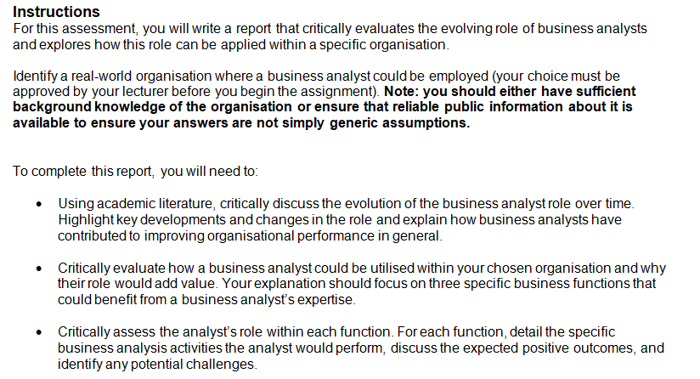
Assessment 1: Report (30% to final grade)
Word count guidance: 1500 words
Due date: Friday Week 3 (16th May 2025), 9:00 AM

Slide 15
Assessment 1 Breakdown
Discuss how the role of Business Analysts have evolved over time and how they have contributed to improve organisational performance in general.
Identify an organisation where a business analyst could be employed.
Evaluate how a business analyst could be utilised in your chosen organisation to improve 3 business functions (operations, IT, marketing etc).
For each function, outline specific business analysis activities, discuss the expected outcomes, and address any potential challenges.

Slide 16
In/Out-of-class activities
Using academic literature, research how the role of business analysts have evolved over time. Highlight key developments and changes in the role and how they have contributed to improving organisational performance.
Identify a particular organisation where a business analyst could be employed. Do some research on the organisation and/or industry that the organisation is in.

